Slide 1
INF526: Secure Systems Administration
Red Teaming and Pen Testing Tools
Prof. Clifford Neuman
Lecture 6
15 February 2017
OHE100C

Slide 2
Class Presentation Schedule
2/8 Miles Wright-Walker - Developing adversarial security plan
2/15 Matthew Jackoski - Red Teaming / Pen Testing Tools
2/22 Abdulla Binkulaib - Developing a response plan
3/1 Jikun Li - Linux security administration
3/8 Daniel Dmytrisin - Network security components & Tech
3/22 Haibo Zhang - Network Security administration
3/29 Mariam Fahad Bubeshait - Configuration Management
4/5 Mohammed Alsubaie – SIEM and Intrusion Detection
4/12 Vishnu Vadlamani - Network Monitoring/Attack Forensics
4/19 Andrew Gronski - Accreditation and acceptance testing

Slide 3
Group Exercise One
Decide on the software components to be deployed to implement software requirements on next slide.
Custom development should be simple scripts.
Use packages for database and other components.
Decide on the VM’s to be created to run those software components.
You can run more than one software component within a VM if you choose.
Decide on the methods you will use to contain access to those software components, and to the information managed by those components.
Configure communication between VM’s and to the outside
Install packages
Write scripts and demonstrate basic flow through system.
Report on progress as group now by email on Tuesday 7 Feb.

Slide 4
INF526: Secure Systems Administration
Penetration Tools
Yatin Wadhawan (Teaching Assistant)
Prof. Clifford Neuman
Lecture 5
17 June 2016
OHE100C

Slide 5
INF526: Secure Systems Administration
Penetration Tools
Yatin Wadhawan (Ph.D. candidate)
Prof. Clifford Neuman

Slide 6
DISCLAIMER
DO NOT USE THESE TOOLS AND METHODOLOGY FREELY OVER THE INTERNET. IT MAY CAUSE DAMAGE TO SOME ORGANIZATION’S CYBER INFRASTRUCTURE WHICH IS A CRIMINAL OFFENCE.THIS TUTORIAL IS JUST FOR LEARNING PURPOSE.
AUTHORS DO NOT ENCOURAGE ANY MALICIOUS ACTIVITIES.

Slide 7
Topics
Ethical Hacking
Types of Hackers
Ethical Hacking Methodology
Information Gathering
Scanning
Attacks
Tools
Case Study: Ukraine Power Grid Attack

Slide 8
Ethical Hacking
Primary motive: To identify the weaknesses of the cyber infrastructure of an organization before an unethical hacker does.
It is legal given testers have taken permission from the relevant stakeholders of the assets on which testing is performed.
It is a subset of an Organization’s security program.
It does not just protect the information but helps organizations to succeed.

Slide 9
Types of Hackers
By Legality
Black Hat
White Hat
Grey Hat
By Knowledge
Script Kiddies
Motivated Attackers
Coders
By Motive
Criminals
Hacktivist
Governments

Slide 10
Ethical Hacking Methodology
Scope
Information Gathering
Scanning
Attacks
Reporting
Result Analysis
Cleanup and Patching

Slide 11
Ethical Hacking Methodology
Scope
Information Gathering
Scanning
Attacks
Reporting
Result Analysis
Cleanup and Patching

Slide 12
Information Gathering
Focused on collecting as much information as possible about the organization you want to compromise.
Motive is to identify the entry and exit points.
Basic Methods:
Passive
WHOIS, NSLookup etc.
Google Dork
DNS Info gathering
Social Engineering
Active
Ping
Traceroute

Slide 13
Information Gathering (cont.)
Passive Methods
To gain information about targeted organization’s cyber infrastructure without actively engaging with the systems.
WHOIS
Anyone can use the this service to search for databases and identify the registrant of a domain name and other information.
It also provides the information regarding: IP address, name servers, admin contact etc.
Link: http://whois.domaintools.com/

Slide 14
Information Gathering (cont.)
Google Dork
It uses Google search engine to find security holes on the web applications over the internet.
To locate specific strings of text within search results.
Link: https://www.exploit-db.com/google-hacking-database/
Some of the Operators
inurl .php?id=
intitle text
site text
filetype pdf

Slide 15
Information Gathering (cont.)
DNS Information Gathering
Resource Records | Description
A | Return IPv4
AAAA | Return IPv6
MX | Mail Exchange Server
NS | Name servers
AXFR | Authoritative zone transfer
IXFR | Iterative zone transfer
SOA | Start of the authority

Slide 16
Information Gathering (cont.)
DNS Information Gathering
dnsenum: Tool in the backtrack Kali OS. It starts querying DNS servers and gather information:
Host address
Name servers
MX records
Gathering SOA records
Command: perl dnsnum.pl [host]
dnsrecon: to gather network infrastructure information.
Dig: DNS information groper
dig example.com MX @ns0.example.com

Slide 17
Information Gathering (cont.)
Active Methods
Interact directly with a system of interest.
Ping
It is used to test the reachability of a system.
It works at the network layer.
It measures RTT, report errors and packet losses.
One can also fix the size of the parameters using -l and number of request using –n.
Command: ping -c 5 www.example.com
Result: 64 bytes from xx.xxx.xxx.xxx: icmp_seq=0 ttl=100 time=23.82 ms

Slide 18
Information Gathering (cont.)
Traceroute
It is used to gather information about network infrastructure and IP ranges of a given host.
Tool for displaying the overall path hop by hop from source to the destination.
By default it sends the UDP packets.
We can modify the command to send TCP/SYN and ICMP requests.
$ traceroute -w 3 -q 1 -m 16 example.com
$ traceroute –I -w 3 -q 1 -m 16 example.com
$ traceroute –T -w 3 -q 1 -m 16 example.com

Slide 19
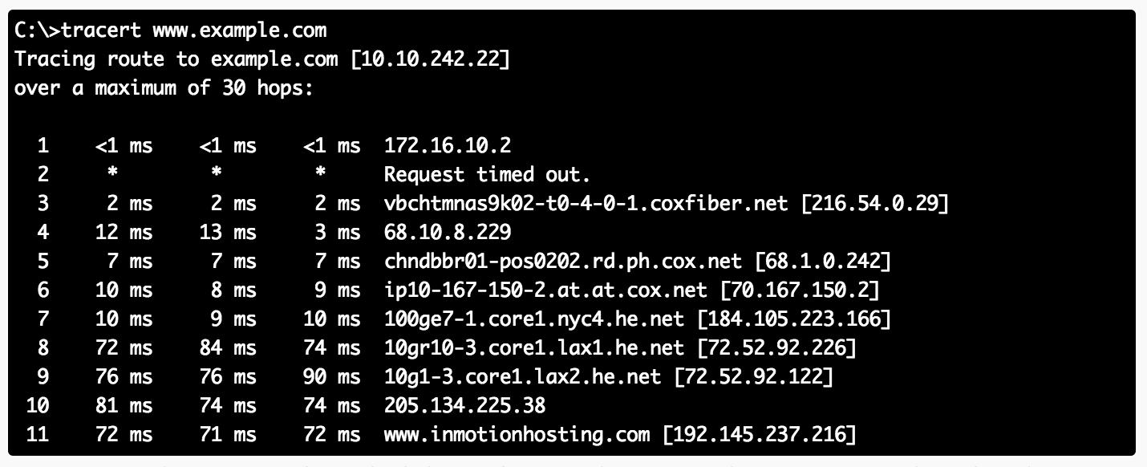
Information Gathering (cont.)
Source: http://www.inmotionhosting.com/support/website/how-to/read-traceroute

Slide 20
Ethical Hacking Methodology
Scope
Information Gathering
Scanning
Attacks
Reporting
Result Analysis
Cleanup and Patching

Slide 21
Scanning
Till now we have understood how to create a profile of the target organization by finding the network information
Now we need to find information about the specific IP addresses that can be accessed over the Internet, OS, accessible ports, network architecture, services running etc.
Types of scanning:
Network
Port
Vulnerability

Slide 22
Scanning (cont.)
Network Scanning
Tool to find out active host on the network
You select the range of IP addresses and start scanning over the network.
It provides the information Network devices including FTP servers and workstations.
Tools:
Advance IP scanner (Windows, Mac and Linux)
Network Mapper (Nmap, ZenMap)
Nessus

Slide 23
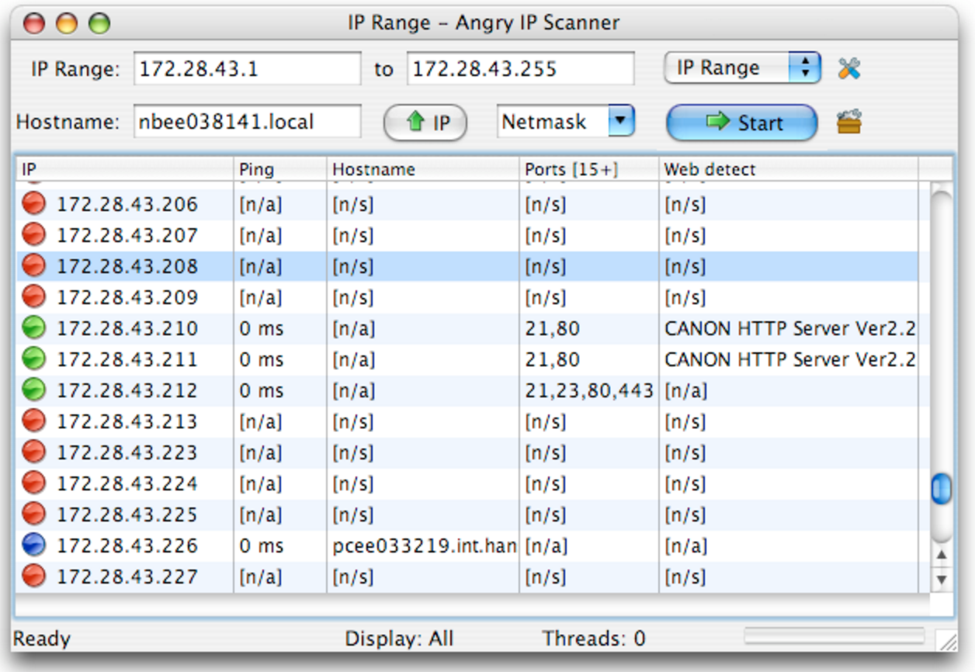
Scanning (cont.)
Source: http://angryip.org/screenshots/

Slide 24
Scanning (cont.)
Port Scanning
Tool to find out which number of ports are accessible on a server or a host.
Port scanning identifies open doors to a hosts.
Nmap classifies port in these States:
Open
Closed
Filtered
Unfiltered

Slide 25
Scanning (cont.)
Commands:
nmap ipaddress
nmap -PN ipaddress
nmap -6 ipaddress
nmap -sP ipaddress (ping scan)
nmap –open ipaddress
nmap -p T:80 ipaddress
nmap -o ipaddress

Slide 26
Scanning (cont.)
Scan examples:
TCP SYN (-sS)
Half TCP connection
UDP Scan (-sU)
Send UDP packets
TCP NULL (-sN)
Does not set any bits (TCP flag header is 0)
TCP FIN (-sF)
Sets just the TCP FIN bit
TCP Xmas (-sX)
Sets the FIN, PSH, and URG flags
OS Detection (–o)

Slide 27
Scanning (cont.)
TCP NULL (-sN)
Attacker
1. Null Packet
Victim
2. No Reply
Port Closed
Attacker
1. Null Packet
Victim
Port Open
2. RST

Slide 28
Scanning (cont.)
TCP XMAS (-sX)
Attacker
1. URG + PSH + FIN
Victim
2. No Reply
Port Open
Attacker
1. URG + PSH + FIN
Victim
Port Closed
2. RST

Slide 29
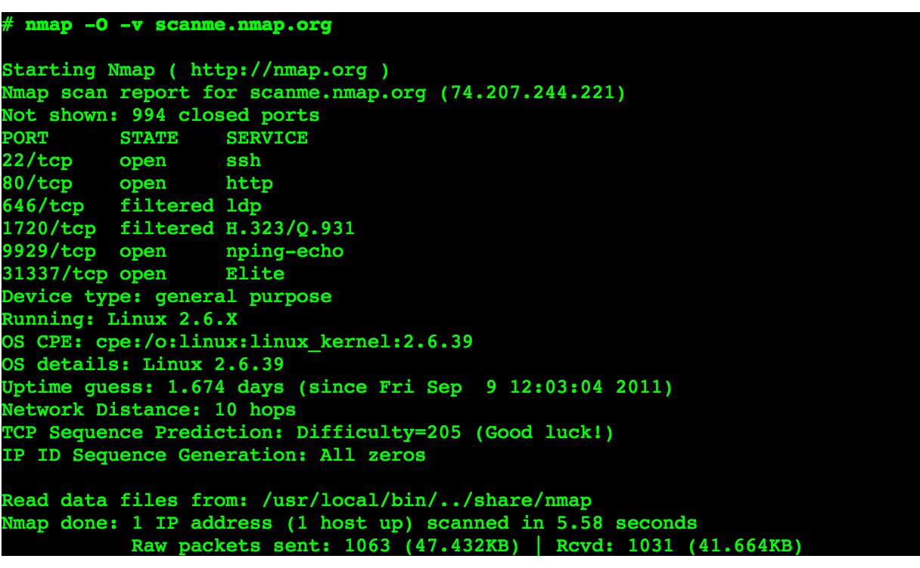
Scanning (cont.)
-O Scan
Source: https://nmap.org/book/osdetect-usage.html

Slide 30
Scanning (cont.)
Vulnerability Scanning
Once we have identified the accessible ports and services running on them, now we need to find the vulnerabilities associated with those applications.
Tools:
Web Application Acunetix, BurpSuite etc.
Network Security Nessus
Mobile Security Veracode, Tenable Security etc.
Web Goat
Insecure web application maintained by OWASP designed to teach web application security lessons.

Slide 31
Scanning (cont.)
OWASP Top 10
Injection
Broken Authentication and Session Management
Cross Site Scripting (XSS)
Insecure Direct Object References
Security Misconfiguration
Sensitive Data Exposure
Missing Function Level Access Control
Cross Site Request Forgery (CSRF)
Using Components with Known Vulnerabilities
Unvalidated Redirects and Forwards

Slide 32
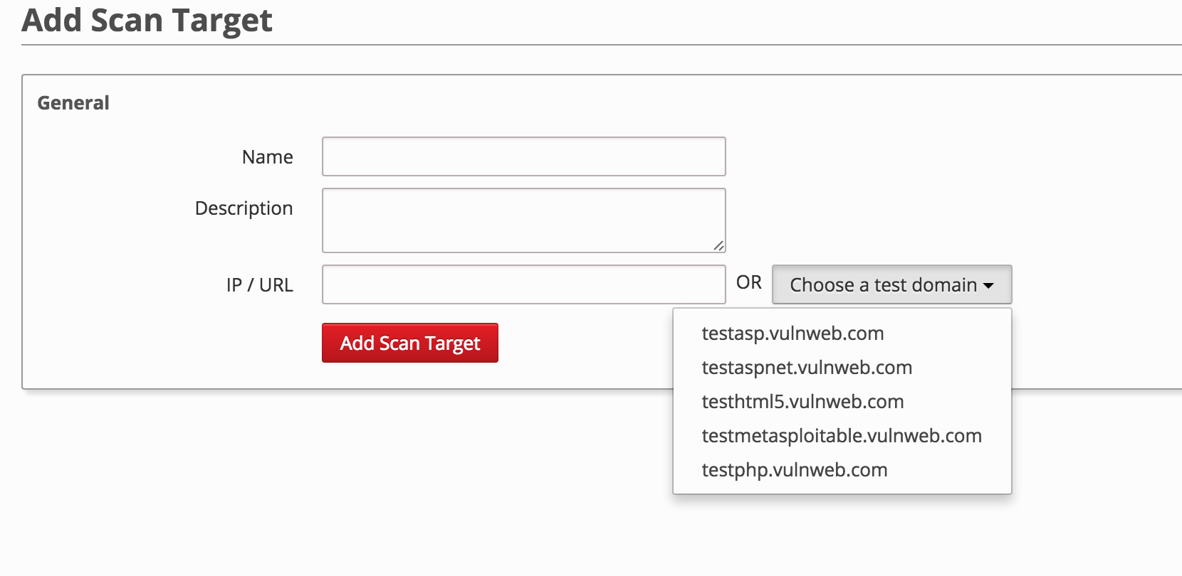
Scanning (cont.)
Acunetix

Slide 33
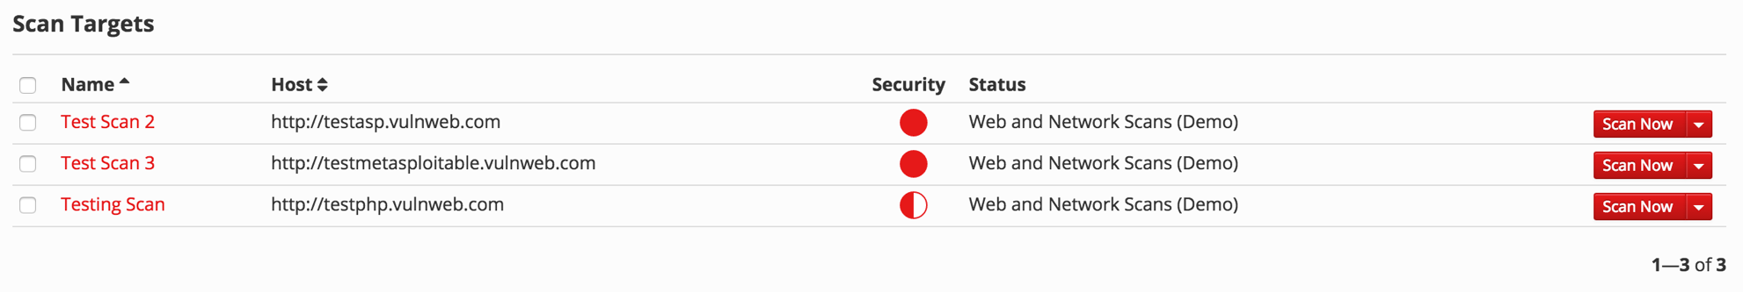
Scanning (cont.)

Slide 34
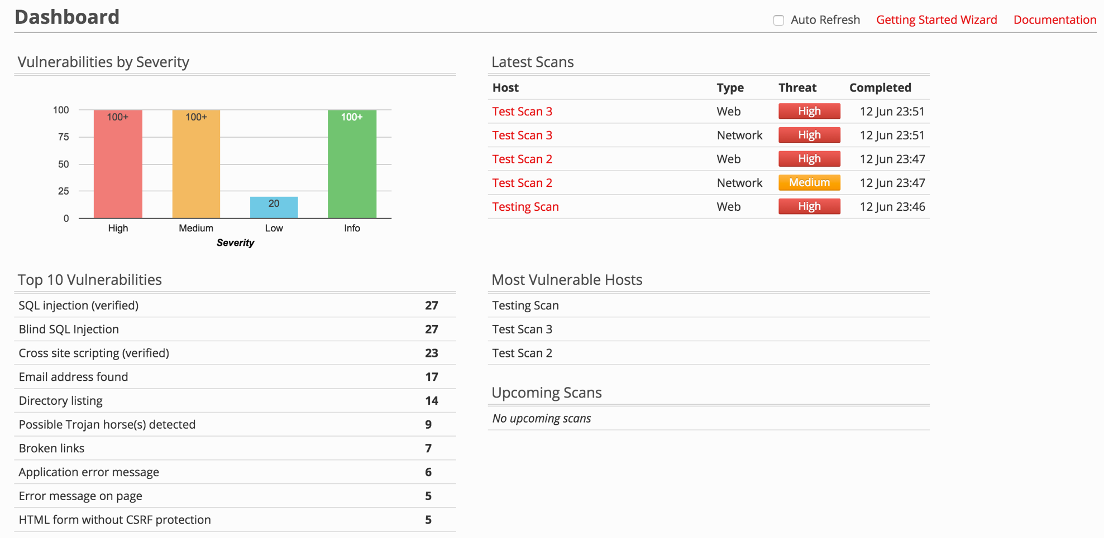
Scanning (cont.)

Slide 35
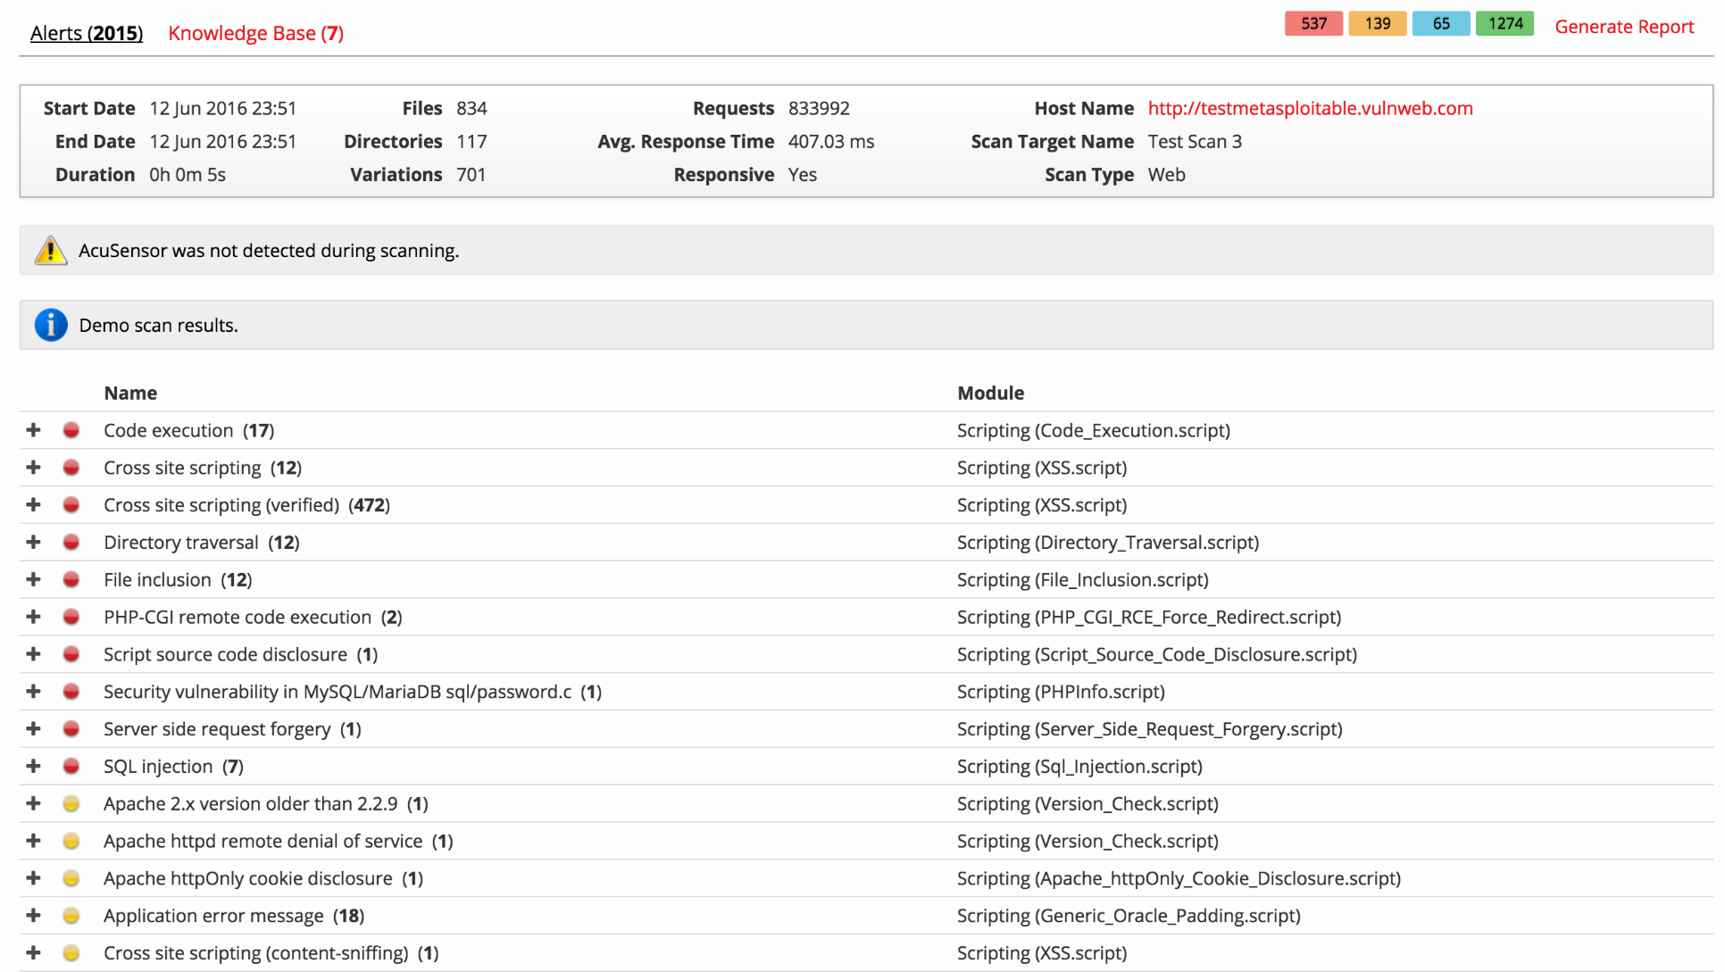
Scanning (cont.)

Slide 36
Scanning (cont.)
CMS (Content Management Servers)
Popular ones are:
Drupal
WordPress
Joomla
Platforms rich in features and vulnerabilities
Open source
Some of the vulnerabilities are:
SQL Injection
Default and weak passwords
Errors reveal sensitive information
By default Directory listing

Slide 37
Scanning (cont.)
Attackers maintain a dictionary of vulnerabilities and corresponding exploits.
For example, if they find an application and its version running on a port. They know whether this version of the application is vulnerable or not. They use their dictionary to verify it.
Now we understand how to exploit the vulnerabilities.

Slide 38
Ethical Hacking Methodology
Scope
Information Gathering
Scanning
Attacks
Reporting
Result Analysis
Cleanup and Patching

Slide 39
Attack
Suppose these are the vulnerabilities we found in the system:
SQL Injection - SQLMap, SQLNinja etc.
Buffer Overflow
Now we will see how we hack into the system by exploiting these weaknesses.

Slide 40
Attack (cont.)
How to plan step-by-step to hack a server?
Exploit SQL Injection
Get Username and password
Upload Shell
Server Rooting
Back Connect to your machine
Find Vulnerability on the server such as Buffer Overflow
Exploit Vulnerability

Slide 41
Attack (cont.)
Exploiting SQL Injection
Idea of exploiting SQL injection is to get access to the data and find out what is the admin username and password on the website.
Once we know this, we can login and upload our shell on the server through which we can escalate our privileges.
In vulnerability scanning phase, we have identified SQL injection vulnerability in a server. Now we exploit that vulnerability manually and using a automated tool SQL Map.

Slide 42
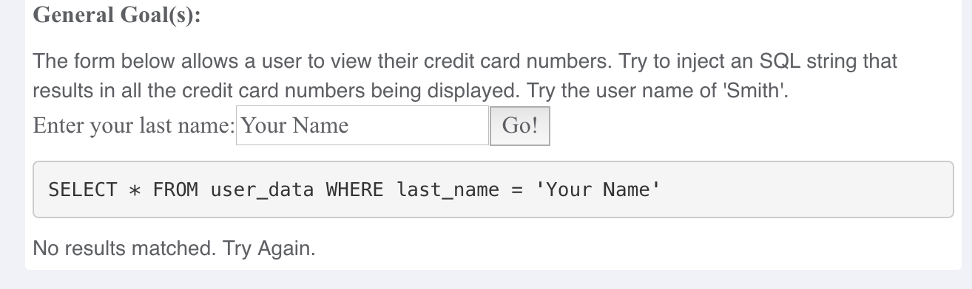
Attack (cont.)
OWASP Web Goat SQL Injection

Slide 43
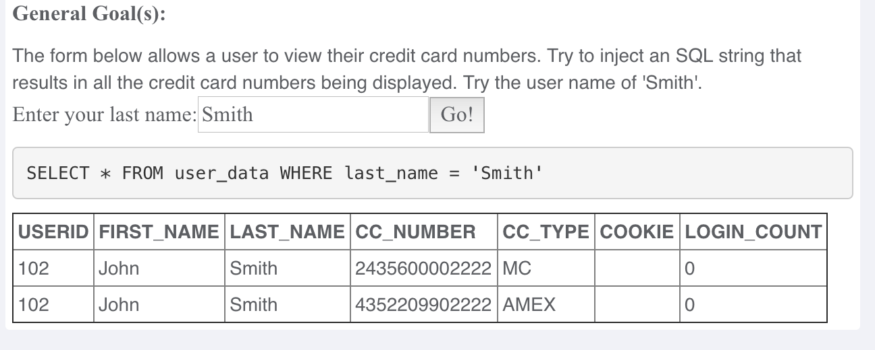
Attack (cont.)
OWASP Web Goat SQL Injection

Slide 44
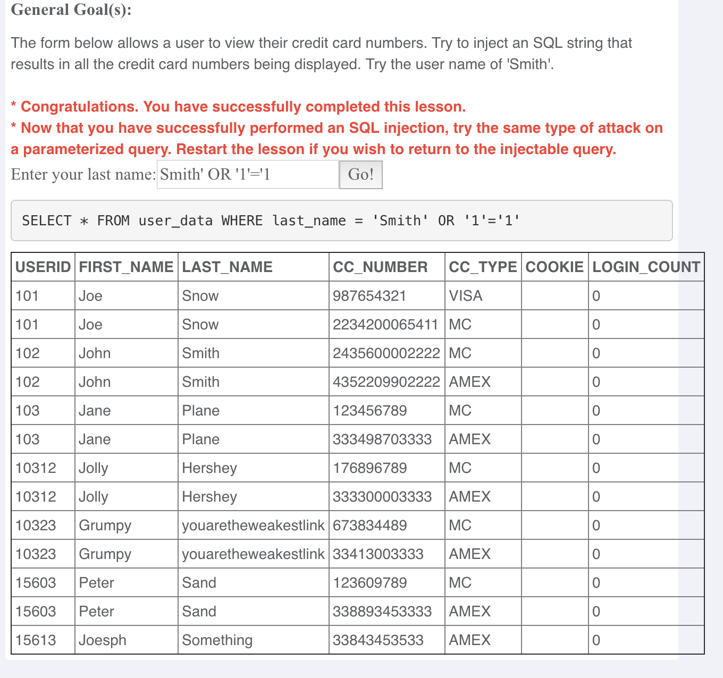
Attack (cont.)
OWASP Web Goat SQL Injection
Query
Admin

Slide 45
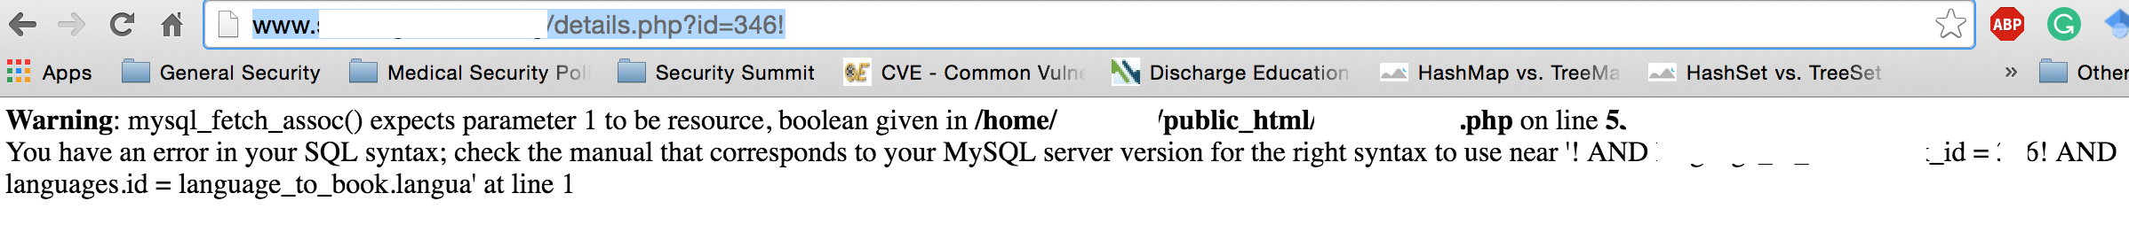
Attack (cont.)
Identify the SQL Injection by changing the URL parameter.
Type: inurl .php?id=
Change the id value. For instance, if id=10, change it to id=10!. See the example below.

Slide 46
Attack (cont.)
Steps to perform SQL Injection
Find vulnerable link (Vulnerability scanning)
Find the databases on the vulnerable website
Find the relevant tables containing username and passwords
Get columns of the table
Get data from the table
SQLMap performs all such actions automatically. You need to provide vulnerable link to it.
You can also run it as commands on cmd.

Slide 47
Attack (cont.)
SQL MAP Commands
Check if link is vulnerable to SQL Injection
python sqlmap.py -u http://www.example.com/authors.php?id=100
Discover Databases
python sqlmap.py -u http:// www.example.com/authors.php?id=100 --dbs
Find Tables of a particular database
python sqlmap.py -u http:// www.example.com/authors.php?id=100 --tables -D databasename
Find the columns
python sqlmap.py -u http:// www.example.com/authors.php?id=100 --columns -D databasename -T users
Get data from the table
python sqlmap.py -u http:// www.example.com/authors.php?id=100 --dump -D databasename -T users

Slide 48
Attack (cont.)
Modify the Request
Suppose after exploiting SQL Injection we have the admin username and password.
We need to login and upload our shell.
Waf performs sanitizing that which type of file is being uploaded on the server. So, we need to by-pass the waf.
We can use Tamper/Scapy to perform this task.
We can change the format of the shell while uploading and use Tamper browser plug-in to capture the http request to change the file extension to original before it is sent to the server.

Slide 49
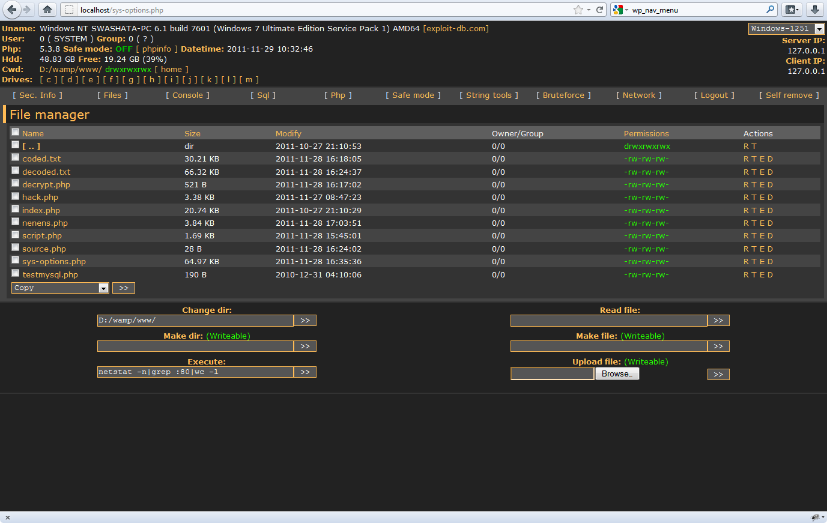
Attack (cont.)
Source: http://anonsquad.blogspot.com/2014/02/tutorial-shell-uploading-guide.html

Slide 50
Attack (cont.)
Back connect
Once shell is uploaded, we need to back connect the server so that we can access all the functionality of the uploaded shell and perform privilege escalation attacks.
For back connect you need to specify the IP address of your computer and Port on which you want to connect on the shell.
You have to shutdown your firewall and router should be configured for the port forwarding feature.
Command for listening: nc -v ipaddress port
Start listening for the connection on the port specified.

Slide 51
Attack (cont.)
Server Rooting
If connect is successful, you should be able to run unix commands such as:
ls
uname –a
whoami
Download the specific exploit on the server using wget command
Use chmod 777 exploit for the full permission
Execute exploit.
If successful, whoami should say root.

Slide 52
Attack (cont.)
Buffer Overflow (BO)
It is a vulnerability where a software, while writing data to a buffer, overruns the buffer's boundary and overwrites adjacent memory locations.
Overwriting values of the IP (Instruction Pointer), BP (Base Pointer) and other registers causes exceptions, segmentation faults etc.
Consists of overflowing the heap or stack depending on the code that developer has written.

Slide 53
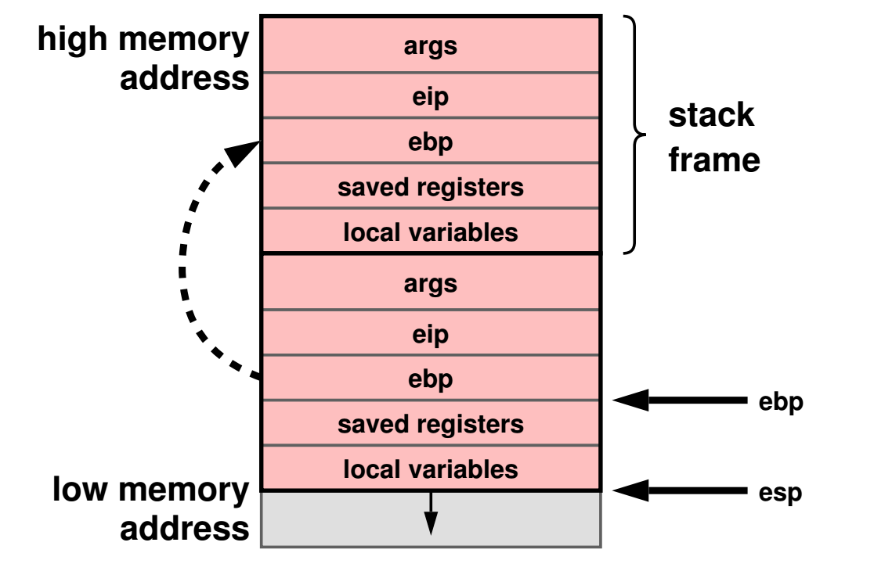
Attack (cont.)
Understanding Stack
Source: Slide of CSCI 402 Operating System: Basic Concepts (Prof. Cheng)

Slide 54
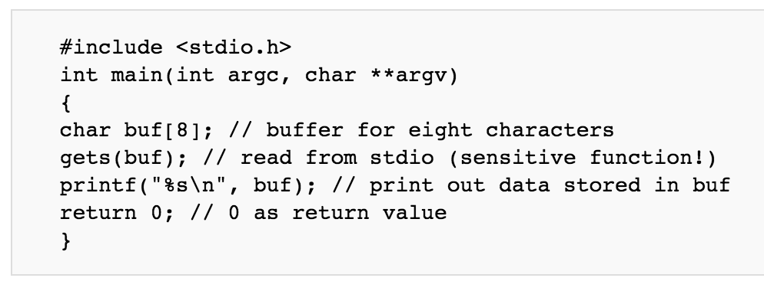
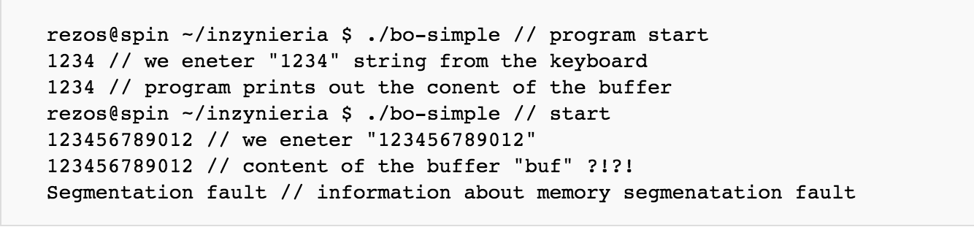
Attack (cont.)
Source: https://www.owasp.org/index.php/Buffer_overflow_attack

Slide 55
Attack (cont.)
Exploit the BO Vulnerability (CIJ)
Crash the program by exploiting Buffer overflow.
Injecting Malicious code in the program
Give the malicious input the program when it crashes.
Jumping to the Malicious Code
When program runs, your malicious code is inside the memory. You need to overwrite instruction pointer with address so that it jumps to place where malicious code is present.
Find the address by understanding the program stack and overwrite the IP.

Slide 56
Attack (cont.)
DDOS Attacks
Network bandwidth by flooding
DNS Amplification
Server resources
TCP SYN flooding
HTTP GET and HTTP POST
Slowloris
Destroy the function of the server or application
Tools:
Trinoo
LOIC (Low Orbit In Cannon)
TFN2K (Tribe Flood Network)

Slide 57
Attack (cont.)
DNS Amplification
IP Address: 1.1.1.1
DNS Server
Victim
IP Spoofing
Source IP Address: 1.1.1.1
Attacker
Bots

Slide 58
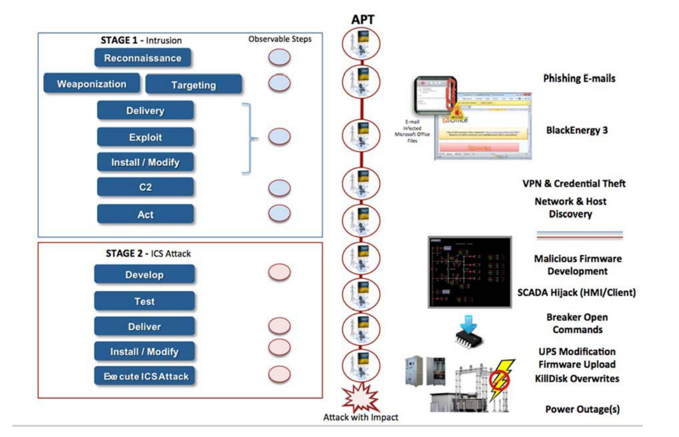
Case Study: Ukraine Power Grid Attack
Source: http://www.nerc.com/pa/CI/ESISAC/Documents/E-ISAC_SANS_Ukraine_DUC_18Mar2016.pdf

Slide 59
Tools
Acunetix | Web Application Security Scanner
BurpSuite | Web Application Security Scanner
Veracode | Application security mobile, web and 3rd party apps.
NMap | Network Scanning and debugging
Wireshark | Network protocol analyzer for Unix and Windows.
NeXpose | Vulnerability Management Software
Nessus | Vulnerability Scanner on Network and applications
Metasploit | Penetration Testing tool. Read: Metasploit The penetration guide (reading)
FOCA | Tool to find metadata and hidden information in the documents its scans.
Scapy/Tamper | Packet Generation and Manipulation Program

Slide 60
Tools (cont.)
Fuzzer | Manipulating network protocol manipulation
AirGrab | Wireless network scanning tool
Wi-Fi radar | Wireless network scanning tool
Acrylic Wi-Fi | Wireless network scanning tool
Aircrack-ng | Wireless network scanning tool
Angry IP scanner | Network Scanning
Netcat | Network Scanning and debugging
Nikto2 | Network Scanning and debugging
Sulley | Fuzzing framework for fuzzing files, network protocols CLAs etc.

Slide 61
Red Team and Penetration Testing Procedures and Tools
M.S. Candidate: Matthew Jackoski
Lecture 6
15 February 2017
OHE 100C

Slide 62
Five Stages of Penetration Testing
Reconnaissance
Scanning
Gaining Access
Maintaining Access
Covering Tracks

Slide 63
Reconnaissance
Probably the longest stage – lasting weeks to months
"If I had eight hours to chop down a tree, I’d spend the first six of them sharpening my axe.”-Abraham Lincoln
Learning as much about the system as possible through a variety of different sources:
Internet Searches
Social Engineering
Dumpster Diving
Domain Name management/ search services
Non-intrusive network scanning
MAKE SURE TO DOCUMENT

Slide 64
Scanning
Scanning the perimeter and internal network devices looking for weaknesses.
Weaknesses include:
Open ports
Open services
Vulnerable Applications (including Operating Systems)
Weak protection of data in transit
Make and Model of LAN/WAN equipment
MAKE SURE TO DOCUMENT

Slide 65
Gaining Access
This is accomplished by using all of information collected in the previous two stages.
Exploiting previously discovered vulnerabilities
Social Engineering
Need to avoid detection.
MAKE SURE TO DOCUMENT

Slide 66
Maintaining Access
Creating a foothold in the network.
Installing a backdoor.
This action is easier for intrusion detection systems to catch.
MAKE SURE TO DOCUMENT

Slide 67
Covering Your Tracks
Need to prove that an attacker can cover his tracks.
This is mostly accomplished by editing/destroying audit logs.
MAKE SURE TO DOCUMENT

Slide 68
Security Minded Linux Distributions
Kali
Parrot Os
BackBox

Slide 69
Most Popular Penetration Testing Tools
Nmap
Metasploit Framework
John The Ripper
THC Hydra
OWASP Zed
Wireshark
Aircrack-ng
Maltego
Cain and Abel (Cain)
Nikto Website Vulnerability Scanner

Slide 70
Nmap
Used to discover hosts and services on a computer network.
Creates a “map” of the network.
Sends packets to host and analyzes response to generate map.
Examples of features:
Os detection
Open Ports
Can adapt to latency and congestion

Slide 71
Metasploit Framework
Tool for executing exploit code against remort machines.
Basic steps:
Chose and configure an exploit
Checking whether target is susceptible to the chosen exploit (optional)
Choosing and configuring payload
Choosing and encoding a stealth method
Executing the exploit

Slide 72
John The Ripper
Password cracking software
Combines multiple password crackers into one program
Auto-detects password hash types
Can be run against various encrypted password formats including:

Slide 73
THC Hydra
Password cracker that works in conjunction with John the Ripper
Fast and stable Network Login Hacking Tool
Uses brute force or dictionary attacks to login to a webpage
Supports multiple protocols:
Mail
POP3
IMAP
Etc
Databases
LDAP
SMB
VNC
SSH

Slide 74
OWASP Zed
Application Security Scanner
When used as proxy server, it allows for the user to manipulate all of the traffic that passes through using https.
Features:
Intercepting proxy server
Traditional and AJAX Web crawlers
Automated scanner
Passive scanner
Forced browsing
Fuzzer
WebSocket support
Scripting languages
Plug-n-Hack support

Slide 75
Wireshark (TShark)
Open source packet analyzer
Uses pcap to capture packets
Allows users to see all traffic, not just the traffic addressed to one of the interface’s configured addresses and broadcast/multicase traffic. (network interface must support promisicious mode)

Slide 76
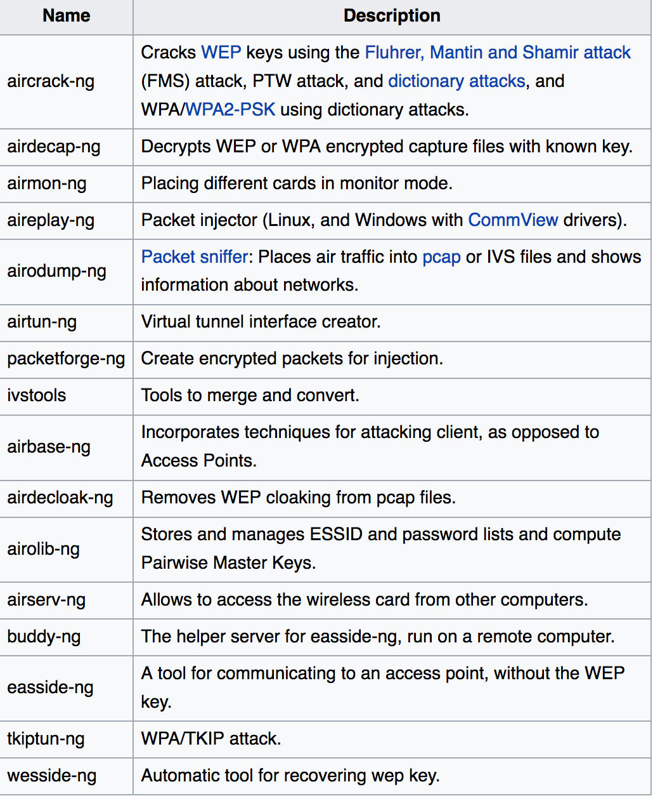
Aircrack-ng
Software includes:
Detector
Packet sniffer
WEP and WPA/WPA2-PSK cracker and analysis tool for 802.11 wireless LANs

Slide 77
Maltego
Used for open-source intelligence and forensics
Allows for creating custom entities, which allows for representation of any type of data.
Main focus:
To analyze real-world relationships between people, groups, websites, domains, networks, internet infrastructure, and affiliations with online services.

Slide 78
Cain and Abel
Password recovery tool for Microsoft Windows
Password cracks are done by dictionary attacks, brute force, and Cryptanalysis
Features:
WEP cracking
Speeding up packet capture speed
Record VoIP conversations
Decoding scrambled passwords
Calculating hashes
Traceroute
Revealing password boxes
Uncovering cached passwords
Dumping protected storage passwords
ARP spoofing
IP to MAC Address resolver
Network Password Sniffer
LSA secret dumper

Slide 79
Nikto Website Scanner
Open Source web server scanner.
Performs comprehensive tests against web servers, including over 6700 potentially dangerous files/CGIs.
Checks for outdated versions
Checks for specific problems associated with over 270 servers.
Checks server configurations for items such as the presence of multiple index files, HTTP server options, and attempts to identify installed web servers and software

Slide 80
Group 1
Abdullah Binkulaib and Dan Dmytrisin have provided initial information, but are having difficulty engaging the rest of group one.

Slide 81
Group 2
Submitted a requirements and design document
Include project scope and assumptions
Data classes, User Classes, and Protection Domains
System Components
System Design
Including Data Flow Diagrams
Including Network Diagrams
Development timeline through end of February

Slide 82
Banking
Your organization must:
Maintain a database of account holders
A database of account balances
Enable web access by customers who:
Can update their personal information
Check their account balance
Transfer funds to another account (by number)
View transactions on their account
Submit an image of a check for deposit
(check should be viewable, but you do not need to scan it or process it)
Access is needed
Via web from the open internet
Outbound email confirming transactions
All other interactions may be limited by information flow policies to internal machines.

Slide 83
Preparation for Lab Activities
Install free version of vmplayer or virtualbox on your own machine
Configure some version / dist of Linux as a guest OS.
Run two instances simultaneously
Configure to allow network communication between the two VMs.
Install a web server on one of the VMs.
Configure Dynamic DNS (e.g. no-ip.com) to enable connection to the server from the internet.
16

Slide 84
Connecting to VMs
VNC – Virtual Network Computing
Install TightVNC or other Client on machine from which access is attempted.
Install and configure VNC server on Virtual Machine
A VNC Server can be run inside your VM, or in the hypervisor
Inside the VM is likely easier
Portmapping a must
Find the IP using dynamic DNS
But multiple VM’s on a shared NAT need to be mapped manually to different ports.
We are trying to gain access to a server under which you can run VM’s which you would connect to the same way you would here, via VNC
Address mapping would be easier.

